Slide 1



Program Overview
A Comprehensive Literacy Solution for Today’s Culturally Diverse Classroom!
Grades K-6

Slide 2
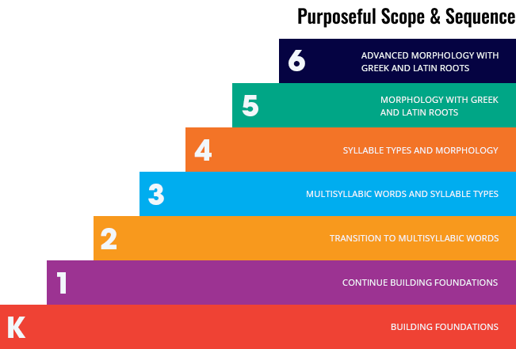
The Foundation
Purposeful scope & sequence and spiral review with repetition cycle
Frequent application to real reading and writing experiences
Built-in differentiation for efficient use of instructional time
Print and digital phonics tools

Slide 3
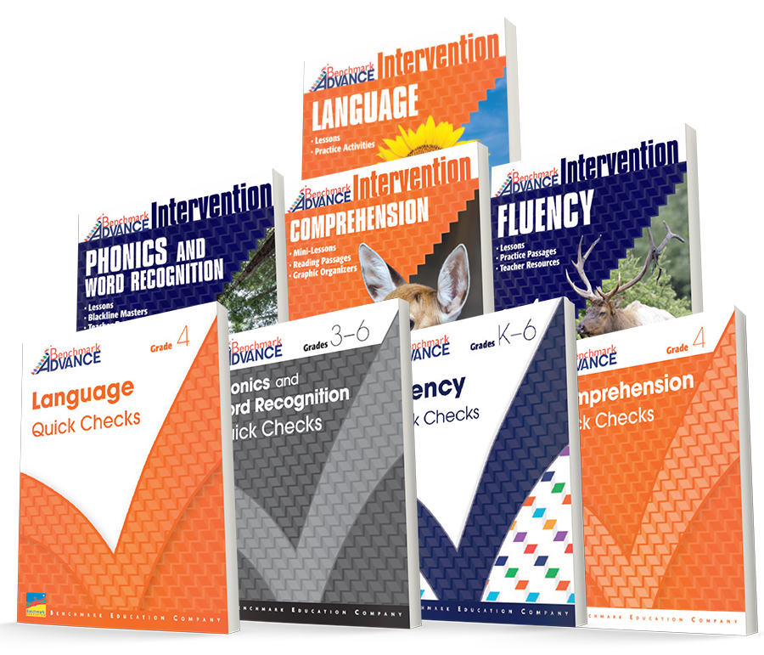
Targeted Intervention Resources to Support Opportunity Gaps
Quick Checks inform exit/entry placement, saving teachers time.
Addresses specific skills tied to assessments for clear next steps.
Instruction scaffolds students to on-grade-level expectations.

Slide 4
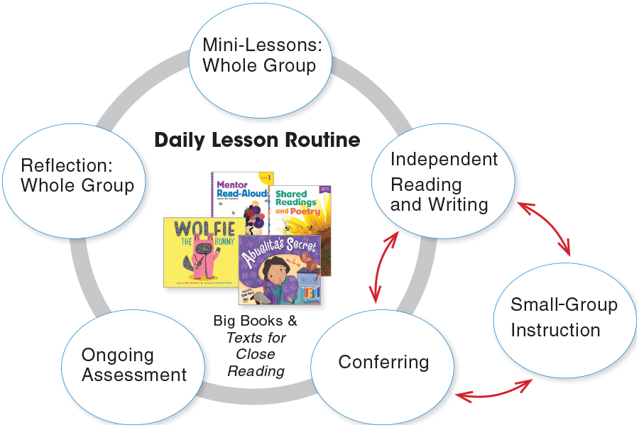
The Time
Benchmark Advance Makes Efficient Use of Your Instructional Time
Predicable routines provide effective use of your time block.
Built-in gradual release of responsibility from whole group to small group/independent time.
Flexible daily lesson plan can fit your district’s language arts block, providing a quick start to implementation.

Slide 5
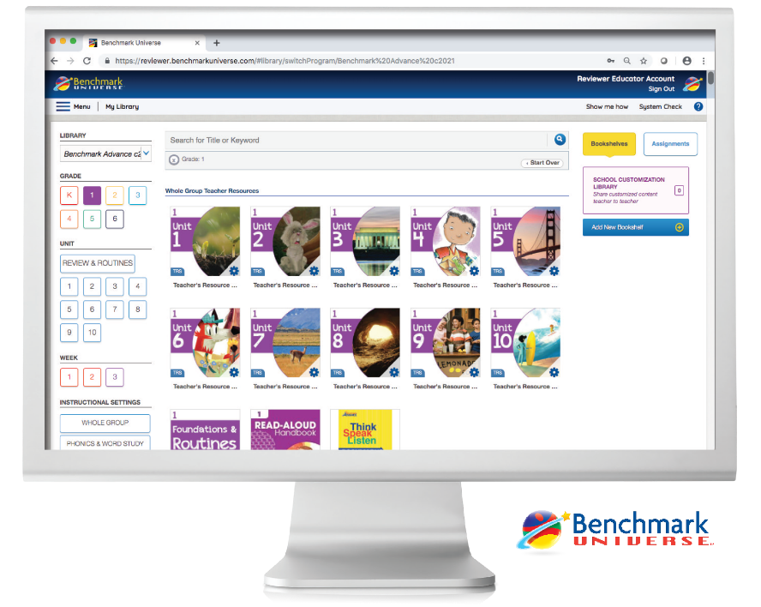
The Technology
Online Portal for Students, Teachers, and Administrators
All Benchmark Advance print components are available digitally, plus additional content and software are available digital-only!
Easy-to-access digital library
Available Anywhere, Anytime

Slide 6

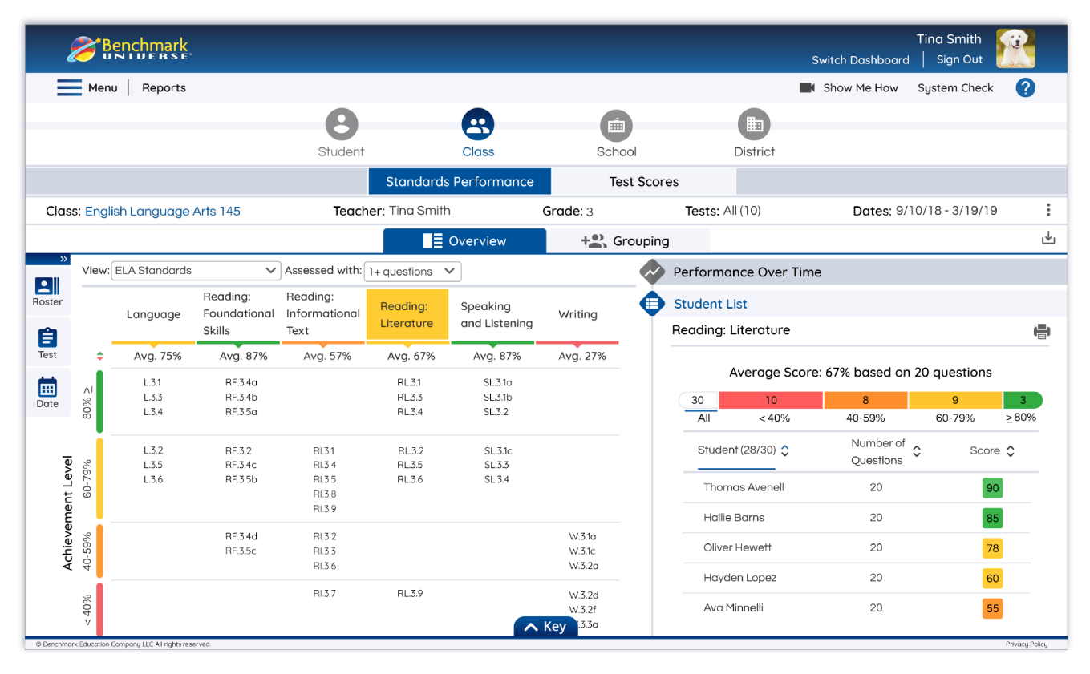
The Data
Tools to Inform Instruction and Monitor Student
Prepare students for the format and environment of state assessments.
Mirrors high-stakes assessment environment
Aligns with ELA Standards
Weekly and Unit Assessments, Interim Assessments, and Performance Tasks are available at every grade, K-6.

Slide 7

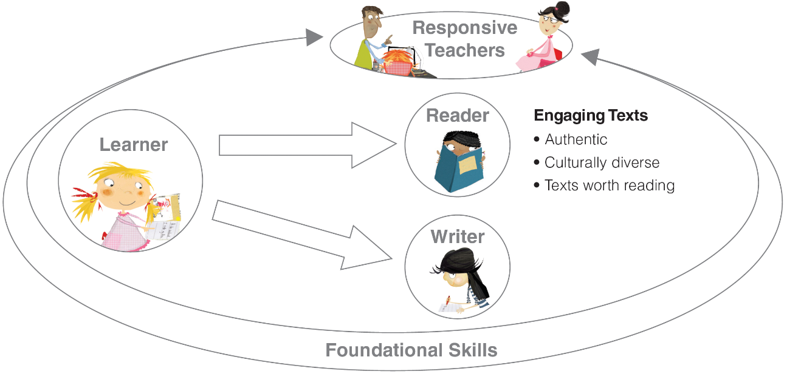
Any questions or concerns regarding the Title I Reading program here at School 5 or Benchmark Advance please contact me at the following email address.
Mrs. Danielle Saldiveri
Title I Reading/Testing Coordinator
dsaldiveri@yonkerspublicschools.org

Slide 8
Program Overview
Click on “Program Overview” and hit play on the video

